Slide 1

IT SOX Update March 13, 2019

Slide 2
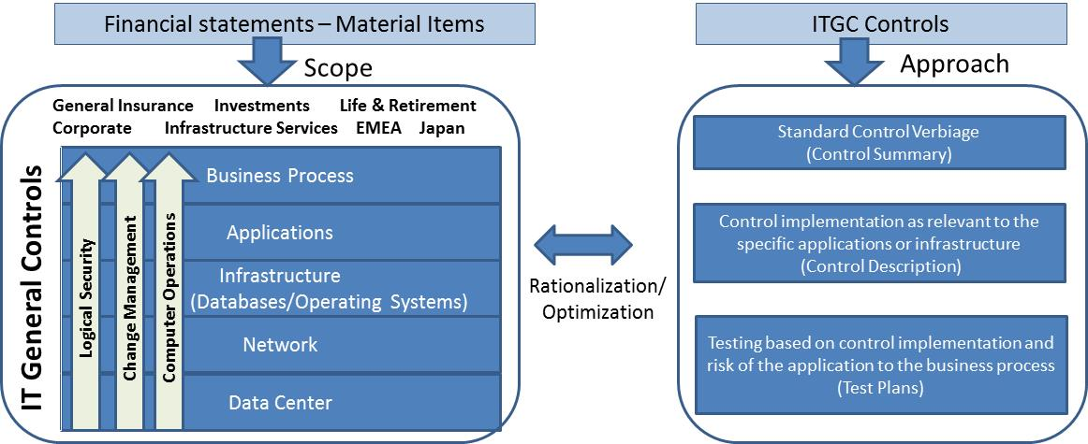
2019 IT SOX Approach
The 2019 IT SOX program will reflect a top-down risk-based approach to testing application and infrastructure controls that are key in ensuring the integrity of the firm’s financial statements. 2019 testing will be supported by automation to reduce time spent in manual efforts with IT teams and increase the level of assurance.
Resulting in an optimized and consistent approach to ITGC SOX controls as well as rationalized application scoping process and testing.
Note: Final 2019 in-scope SOX controls are pending discussion with PwC
2

Slide 3
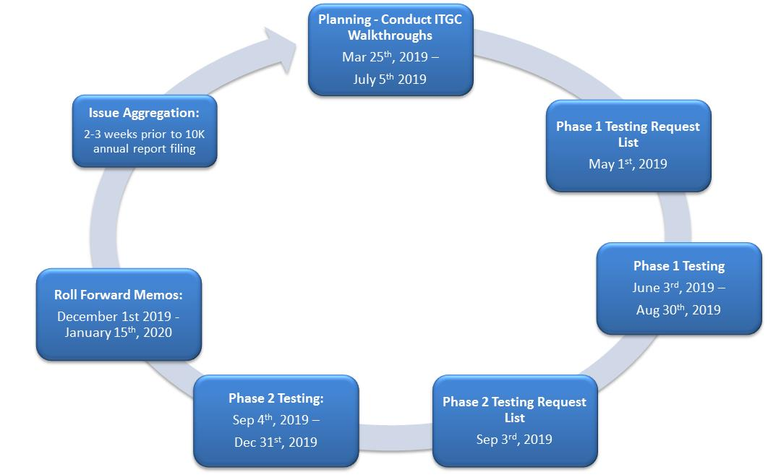
2019 IT SOX Draft Timeline
The IT SOX program consists of the following key phases:
Planning Walkthroughs – Sessions are held with the Process owners to confirm and assess control design from beginning to end, including handshakes with other areas, changes from prior year, or anticipated significant changes.
Testing – Detailed testing is performed to assess operating effectiveness of application and infrastructure controls. Phase 1 – approximately 75% of the samples tested; Phase 2 – approximately 25% testing.
Roll Forward Memos – Confirmation of continuous control operation through year end is performed.
Issue Aggregation – Analysis of control deficiencies open at year end is performed to determine if, in the aggregate, they could result in the likelihood of material mis-statement to financial reporting.
Remediation Testing - Control deficiencies reported closed by management are re-tested throughout the year to confirm effective operation of the remediated controls.
Remediation Testing (Ongoing throughout the year)
3

Slide 4
IT General Controls (ITGC) Approach
As part of the ITGC planning, IT SOX team will work with IT management to confirm control owners for each in-scope process and sub-process. Planning walkthroughs will be conducted with the control owners to confirm the design of IT general controls, which will enable us to develop operating effectiveness testing approach.
Planning Objectives:
Identify control ownership
Re-confirm understanding and/or identify changes to the controls end-to-end
Assess the control design by observing a control demonstration, along with the supporting documentation as applicable
Re-confirm control candidates for automated testing and/or identify new opportunities for automated testing
Planning Approach:
ITGC walkthrough schedule is grouped by Sub-Process, with a defined timeline range for completing walkthroughs . Depending on the support model, there could be instances when the walkthroughs will be combined by entity (e.g. EMEA).
Where applications or infrastructure have been on-boarded to the homogeneous processes, a combined walkthrough of the process will be leveraged to assess the control design.
In-Scope SOX ITGC Controls
Process | Sub-Process
Logical Security | Access Recertification
 | Privileged Access
 | Privileged Access Logging and Monitoring
 | Server Configuration Monitoring
 | User Access De-provisioning
 | User Access Provisioning
 | User Transfers
 | Segregation of Duties
Computer Operations | Data Back up and Monitoring
 | Job Monitoring
Change Management | Change request approval and testing
Note: While SDLC controls are not part of the standard SOX program, they may be assessed for specific projects that are deemed material for SOX.
4

Slide 5
IT Dependent (ITD) Controls Approach
As part of planning for IT Dependent controls coverage, IT SOX team will participate in select walkthroughs of the business processes in order to identify key IT dependencies (e.g. systems, reports, etc.). Subsequent follow ups with the IT team will be conducted, as needed, to understand the corresponding application controls and determine testing approach.
In-Scope SOX IT Dependent Controls
Control Type | Objective | Control Considerations
Automated Controls | Controls designed to ensure the complete and accurate processing of data | Data edit/validation checks
 |  | Blocks to prevent the file from processing if the record count doesn’t match
 |  | System enforced segregation of duties
Interface Controls | Controls designed to ensure complete and accurate communication between the systems | Controls in the source/destination systems
 |  | System logic for data flow handling
 |  | Controls over data completeness and accuracy
Key Reports | A system generated document that supports execution of a key business control (e.g. exception reports, sales summaries, etc.) or directly supports a material/ financially significant accounting entry or decision | Process for making changes to the key report(s)
 |  | Parameters used to run the query
 |  | Accuracy and completeness of the data source
5

Slide 6
ITGC Walkthroughs – Roles & Responsibilities
Process/Control Owners
IT SOX Team
Pre-meeting
Ensure the right individuals are available for the meetings
Prepare required documentation (one complete sample of 2019 documentation)
Provide up to date process flows and narratives, as applicable
Meeting
Provide an end to end description of the process
Highlight any changes to the process from 2018
Walk through one current year sample for each control
Automation
Post Meeting
The IT SOX team may follow up with the control owner for additional information or meeting, as needed
Review and confirm the accuracy of the updated process flows and control matrices, including ensuring control descriptions accurately reflect the way control activities are performed
Pre-meeting
Coordinate walkthrough meeting schedules and logistics, including PwC coordination
Provide control owners current control matrix and prior year documentation, if applicable
Meeting
Document the end to end process
Work with the control owners to update process flow diagrams, narratives, and Risk and Control Matrices (RCMs) to accurately reflect key control points
Assess the design of controls
Post Meeting
Formally document the walkthrough and update process flows, as needed
Work with the process owners to resolve any design issues identified
6

Slide 7
ITGC Walkthroughs – Draft Timeline
Individual control walkthroughs will be scheduled within the indicated time periods. A walkthrough typically takes 1-2 hours; in the instances where multiple controls are combined into one walkthrough or the environment is more complex, additional time may be needed. The IT SOX team will continue to partner with control owners to identify efficiency opportunities in walkthrough scheduling.
* Refer to slide 10 for EMEA timeline by entity
7

Slide 8
ITGC Walkthroughs –Draft Timeline (cont.)
8

Slide 9
ITGC Walkthroughs – Draft Timeline (cont.)
9

Slide 10
ITGC Walkthroughs – Draft EMEA Timeline by Entity
10

Slide 11
Appendix: IT General Controls (ITGC) Scope Rationalization
The following controls are proposed for removal from the standard SOX program, either because the risk is already covered in other controls or the control is operational or has no direct impact to financial statements.
Process | Sub-Process | Rationale | Rationale Detail
Computer Operations | Job Schedule Changes | Covered by existing control | Changes to the job scheduler follow the standard change management process and will be covered as part of the change management testing. Access to the job scheduler will be covered as part of the logical user access testing.
 | Production Monitoring | Non-SOX control | This is an operational control but not key for SOX in the context of material mis-statement risk (books and records)
Change Management | Separation of environments | Covered by existing control | This control is focused on achieving segregation of duties through the separate environments. Segregation of duties is already captured as a separate control, addressing the risk of developer access to production.
 | Version Control | Covered by existing control | Control is focused on access to source code. Access appropriateness (provisioning, de-provisioning, certification) is captured under logical user access controls.
Logical Security | Perimeter Security | Covered by existing control | Key risk is addressed under password controls, privileged access, as well as privileged access logging and monitoring controls which are captured separately.
Physical Security | Provisioning, De-Provisioning, Re-certification | Non-SOX control | This is not key for SOX, in the context of materials mis-statements, as physical access doesn’t directly impact books and records.
SDLC | Data Conversion Documentation & Training Program Implementation Project Governance Testing | Non –Key control | SDLC controls would only be relevant to specific projects that impact financial statements. While these controls are removed from the standard SOX program, they may still be assessed for specific projects that are deemed material for SOX and would be determined during the annual scoping effort.
11
3

